Slide 1
PSID :
Problem Statement Title : New age women safety
Team Name :
Team Leader Name :
Institute Code (AISHE) :
Institute Name :

Slide 2
PROBLEM , EXISTING SYSTEM and SOLUTION
PROBLEM : Street harassment and the feeling of being unsafe in the streets and also the fear of hidden cameras at various public place,limit women’s mobility and access to public spaces.
Currently the courseware used to safeguard women, can be easily deactivated by anyone by just uninstalling it from the device. As a result, the guardian may lose the exact location of the user and lead to consequences.
The proposed solution is a system which uses
emergency SOS service,
Hidden camera detector manually or by the electromagnetic field simulation,
Women news
siren alarm.

Slide 3
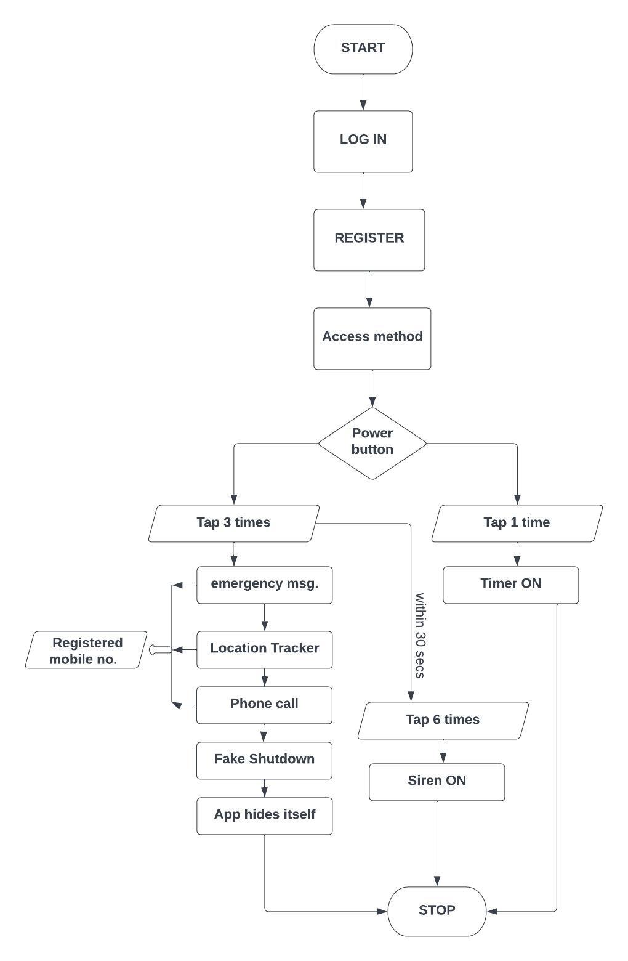
PROPOSED SYSTEM
Emergency SOS Service:-Save maximum 4 relative’s phone numbers and tap power button three times whenever you are in trouble.
An Emergency SOS message embedded with live location will be sent to all the four relative’s phone numbers and a phone call will be made to the first relative even when the phone is locked because this works in background.
Hidden Camera detector:-Move the phone around the suspected places and if the app finds any camera ,then the app will start beeping.
Women’s News:- Read women empowerment and struggle news to get empowered.
Siren Alert:- Tap the siren button or power button six times,and a siren alarm will start to deviate the culprit.

Slide 4
FEATURES
Technologies and Libraries used:
Java
XML
Shared Preferences for storing local data
Implicit intents for sms,call and email
Fused Location Provider Client API for efficient user location retrieval
Background Service
Broadcast Receiver
Media player api
Magnetometer Sensor
SMS Manager API
Sensor Manager API
Retrofit Library
News Api
Airbnb’s Lottie animations
Save phone numbers of your trusted relatives in your local storage,
App hides itself from the user for security reasons.
Send Message with live location and make phone call by just tapping the power button three times.
Siren alarm by just tapping the power button again three times to deviate the culprit.
Detect any hidden spy camera by just scanning the suspected places.
“Fake shutdown” feature to perform a fake power off in the lock screen.
Data is encrypted in transit.

